Slide 1
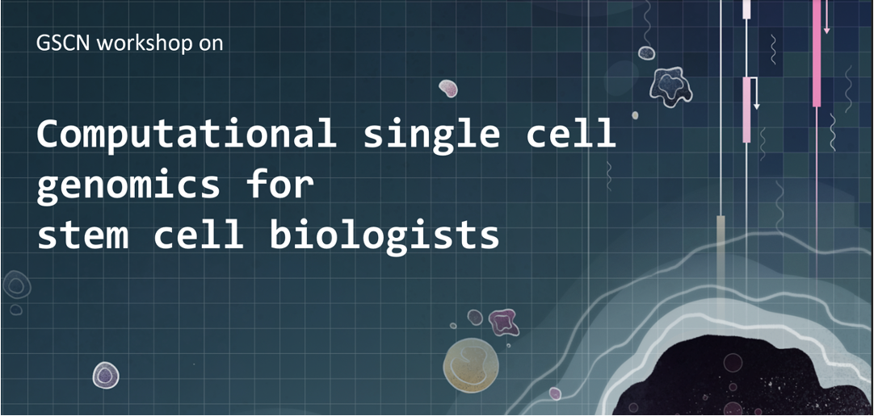
November 7 - 8

Slide 2






Computational single-cell genomics for stem cell biologists
Sara Jiménez
Machine learning group, CHC
November 8, 2024
sarajimenezc
sarajimenez

Slide 3
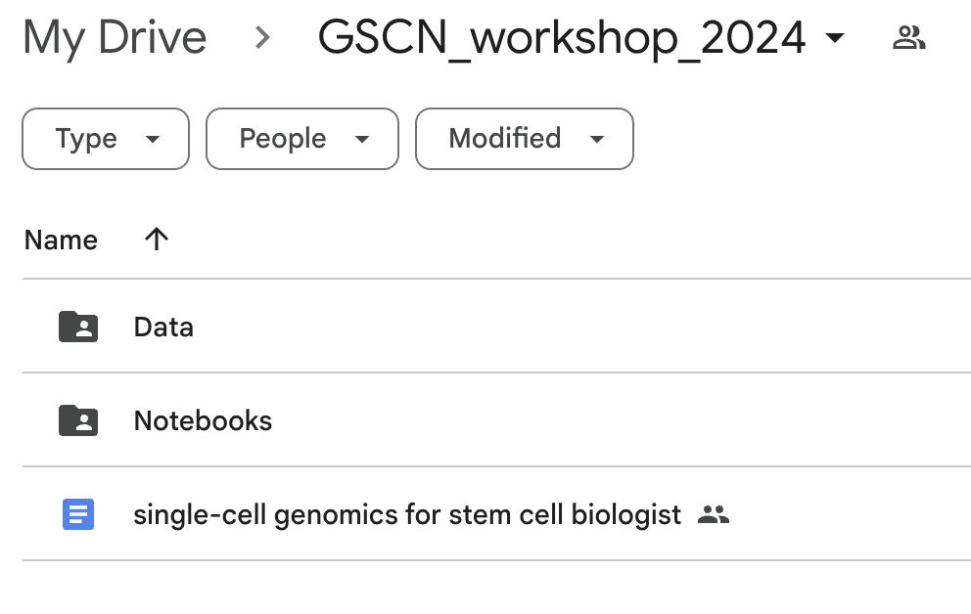
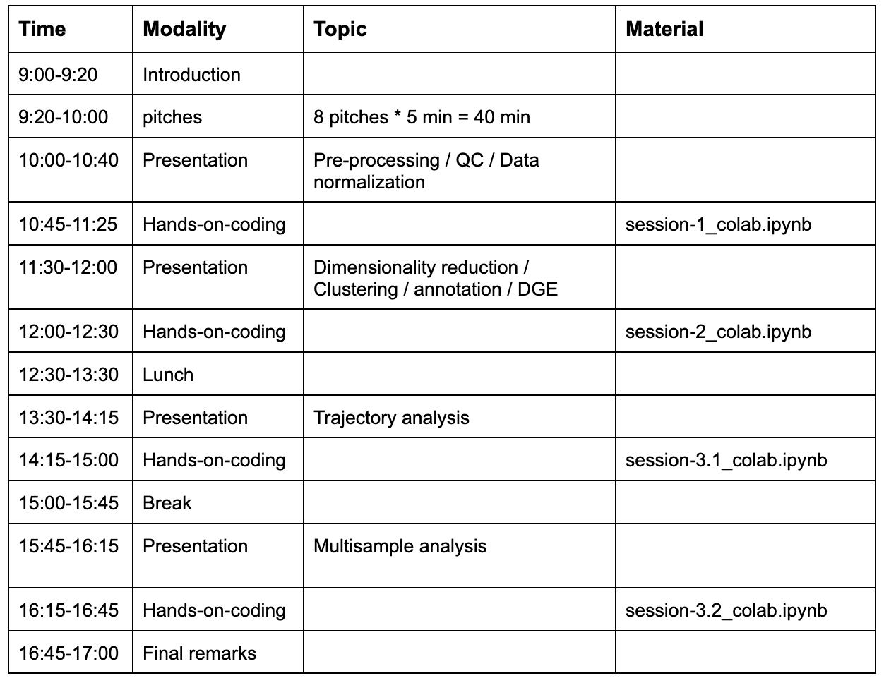

Overview of this workshop
✅
✅
https://sarajimenez.github.io/GSCN_workshop_2024/

Slide 4
Post data pre-processing: - Data normalization - Highly Variable Genes - PCA - Nearest Neighbor Graph - Visualization, Clustering, annotation

Slide 5
Highly Variable Gene Selection
Generally, all genes may not be important to understand the biology
A key idea in machine learning: feature selection
Not all the features that we collect are useful to understand the phenomenon
For example, in biology we expect to see lots of house keeping genes
Solution proposal: Focus on the genes that are highly varying, i.e. how much gene expression varies between cells
Assumption: Genes that have low variance may not indicate any biological signal in the data
Taking out those genes might therefore strengthen the signal in the data, while reducing nuisance signal
It moreover makes computations faster, since the number of genes is often reduced dramatically after performing HVG selection (minor benefit)
How do we identify varying genes: those that diverge from the general trend in variance.
Catch: Variance of a gene is generally proportional to its mean expression, therefore we consider coefficient of variation (variance normalized by the mean) against the mean of the gene

Slide 6
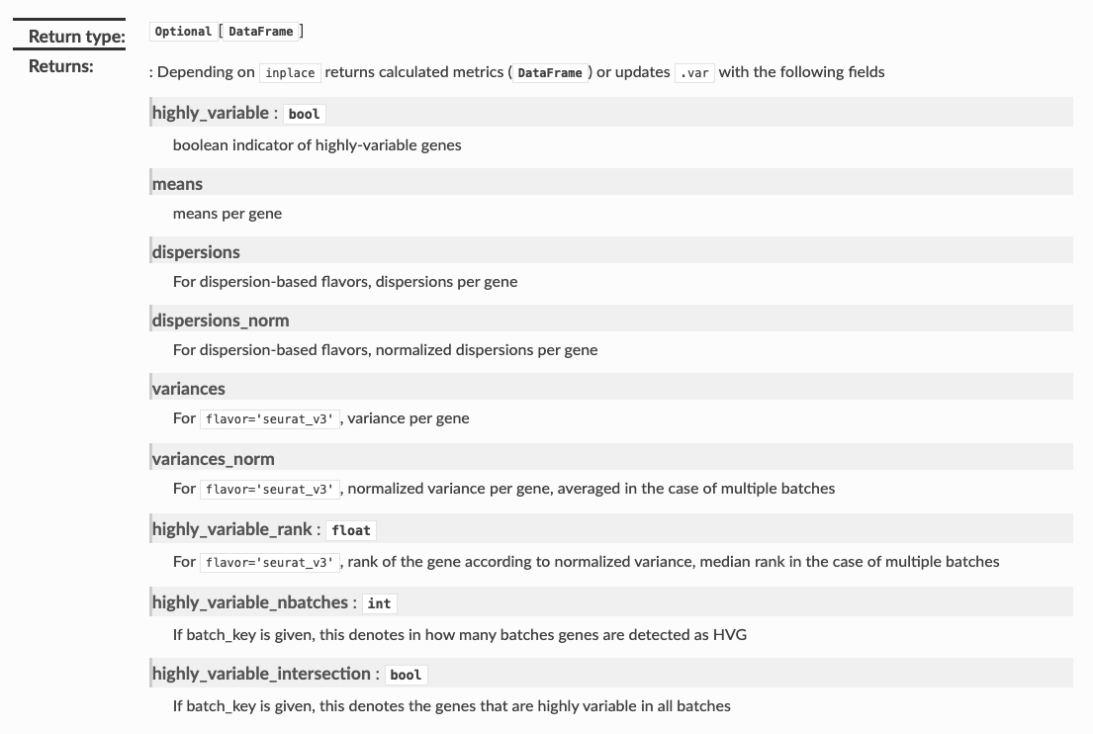
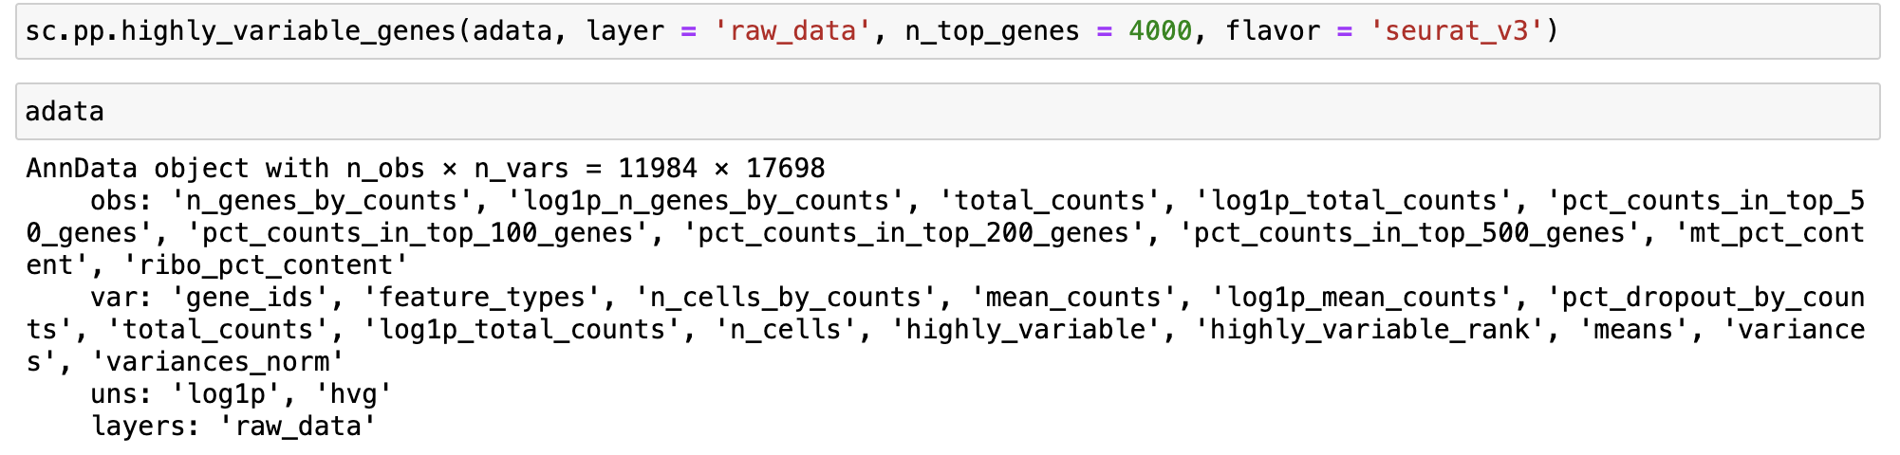
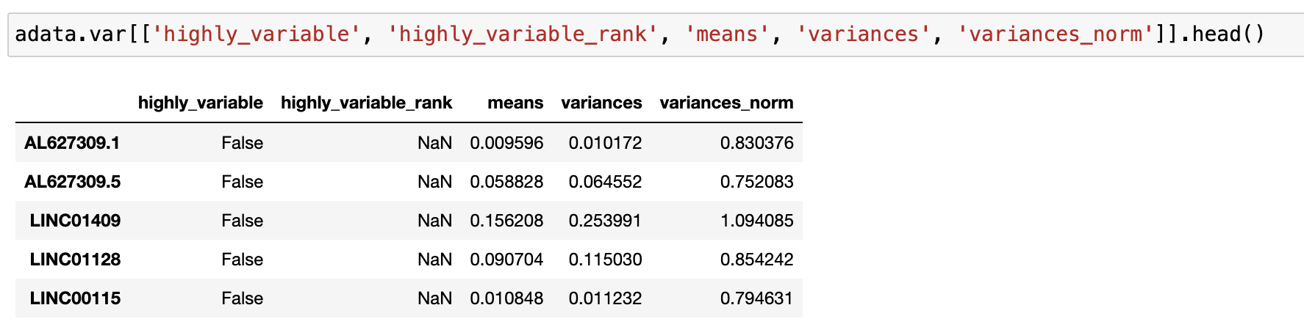
Highly Variable Gene Selection

Slide 7
Highly Variable Gene selection
Important Note:
Once you compute HVGs, please check to find if the genes you know are relevant to your study are included in that list or not.
If not, please feel free to manually append them to the list.

Slide 8
Post data pre-processing: - Data normalization - Highly Variable Genes - PCA - Nearest Neighbor Graph - Visualization, Clustering

Slide 9
Dimensionality reduction, PCA
PCA is a dimensionality reduction algorithm to obtain "directions of highest variances.”
What does dimensionality reduction mean?
A typical scRNA-seq experiment measures the mRNA transcripts of all the genes (~20,000)
These genes represent features or dimensions or parameters that we measure for each cell
These features define the phenotype of each single cell
Gene C
Cell phenotype vector
Gene B
Gene A

Slide 10
Dimensionality reduction, PCA
PCA is a dimensionality reduction algorithm to obtain "directions of highest variances.”
What does dimensionality reduction mean?
A typical scRNA-seq experiment measures the mRNA transcripts of all the genes (~20,000)
These genes represent features or dimensions or parameters that we measure for each cell
These features define the phenotype of each single cell
Key: Genes and their products inside cell form modules => a lot of genes are co-regulated and co-related
Thus, by measuring so many features from a single cell, we obtain redundant information
There might be only a few key variables (possibly hidden) that are driving the underlying biological process
The notion of dimensionality reduction is thus to extract those few meaningful dimensions that are reflective of the true underlying biological process

Slide 11
Gene C
Cell phenotype vector
Gene B
Gene A

Slide 12
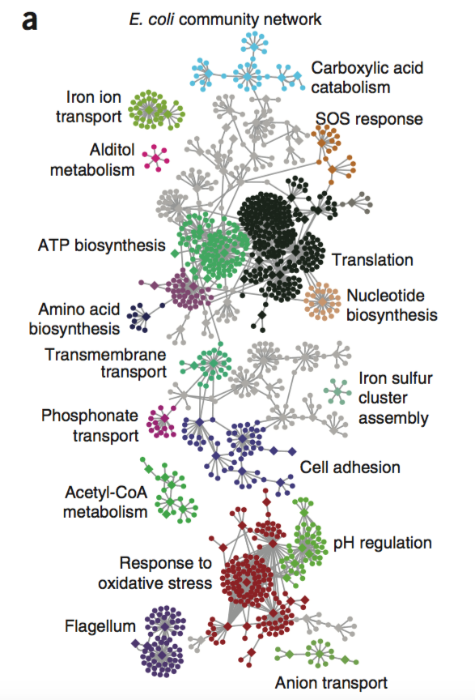
The phenotype space is really a low-dimensional object embedded in high-dimensions
Gene-gene network in E. coli
Gene C
Gene B
Gene A
Why is that so?
Co-regulation of genes results in gene modules
Lots of redundancy/dependency among measured parameters
Even though we measure so many parameters, few key variables (could be latent) drive the process
Marchbach et. al. 2011

Slide 13

Dimensionality reduction, PCA
How does PCA work?
PCA operates by computing the eigenvectors of the co-variance matrix of the data
Because it looks at the co-variance matrix of the data, the eigenvectors are associated with directions of highest variance in the data
The amount of variance explained is proportional to the associated eigen-value
http://www.nlpca.org/pca_principal_component_analysis.html

Slide 14
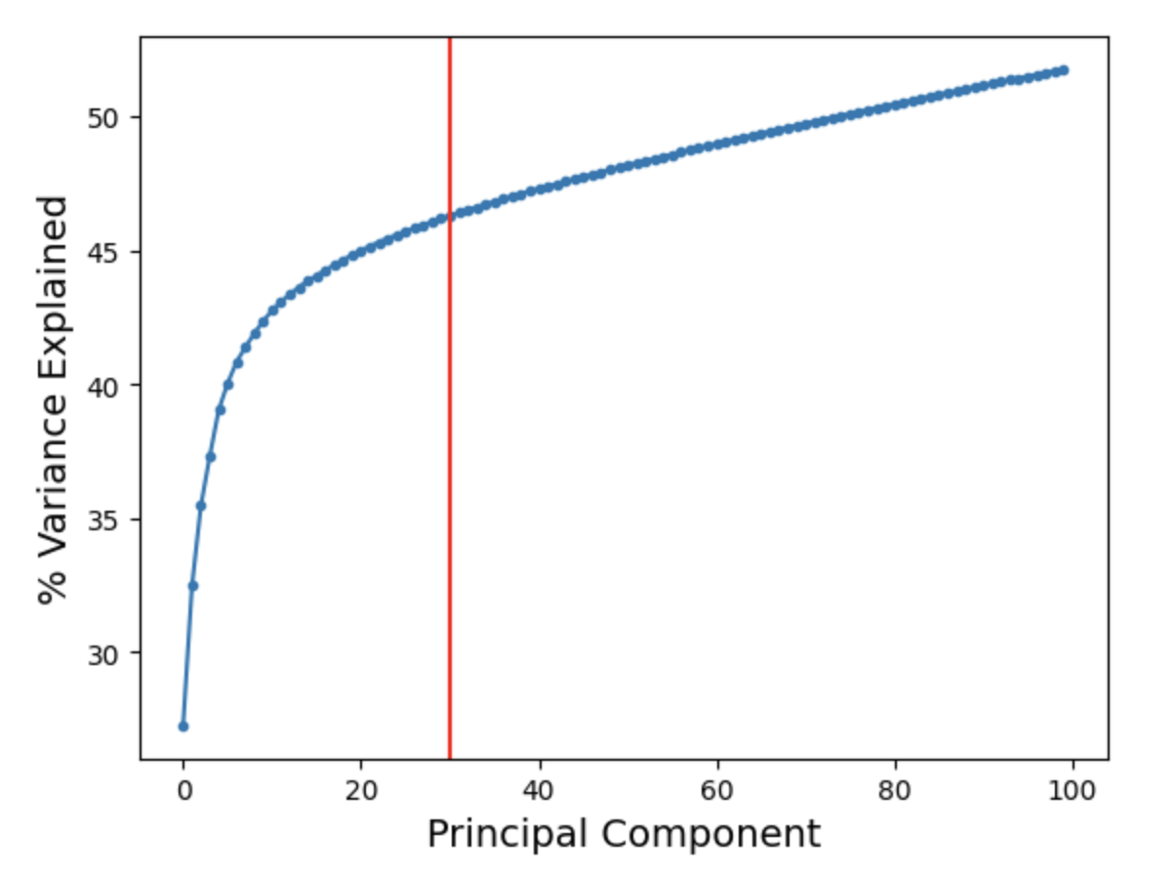
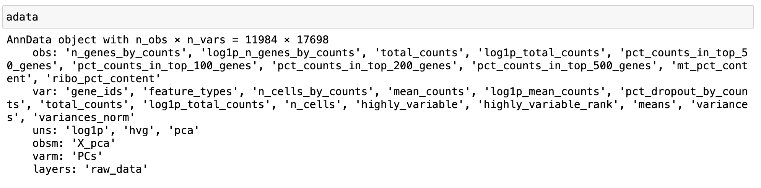
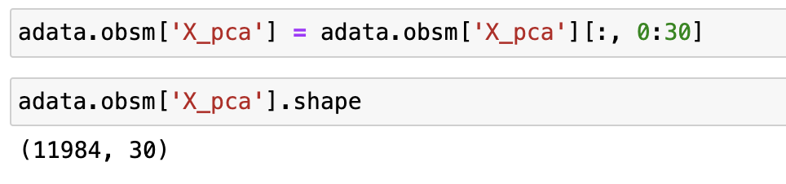
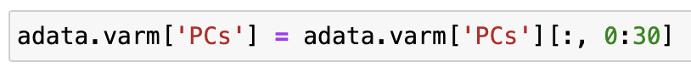
Dimensionality reduction, PCA

Slide 15
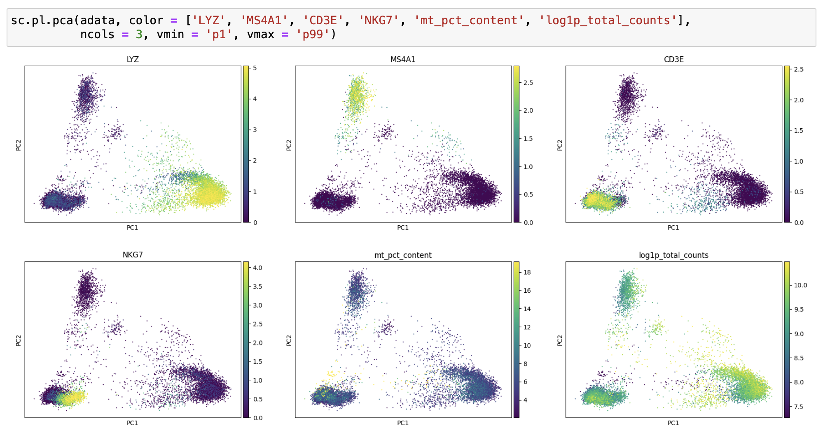
Dimensionality reduction, PCA
Can visualize data using the PCA, but still have 30 dimensions.
Moreover, PCA is a linear method and does not capture non-linear gene-gene relationships.
Need alternatives to summarize so much information.
Question: What do we want to capture using visualization?
Visualize in 2D or 3D
Ensure that cells with similar phenotype are plotted near each other => cells similar to each other in high dimensions must be visualized near each other in 2D
Ensure that non-linear relationships among the features (genes) are captured.

Slide 16
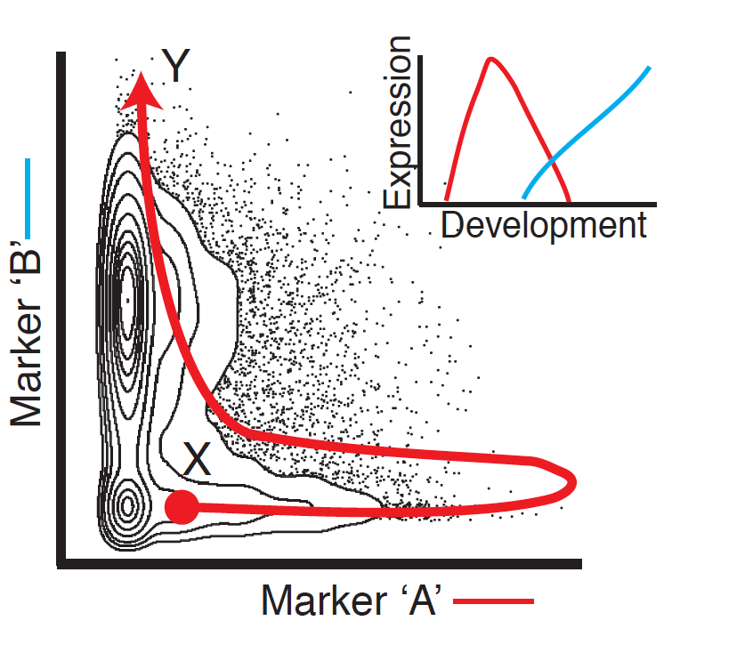
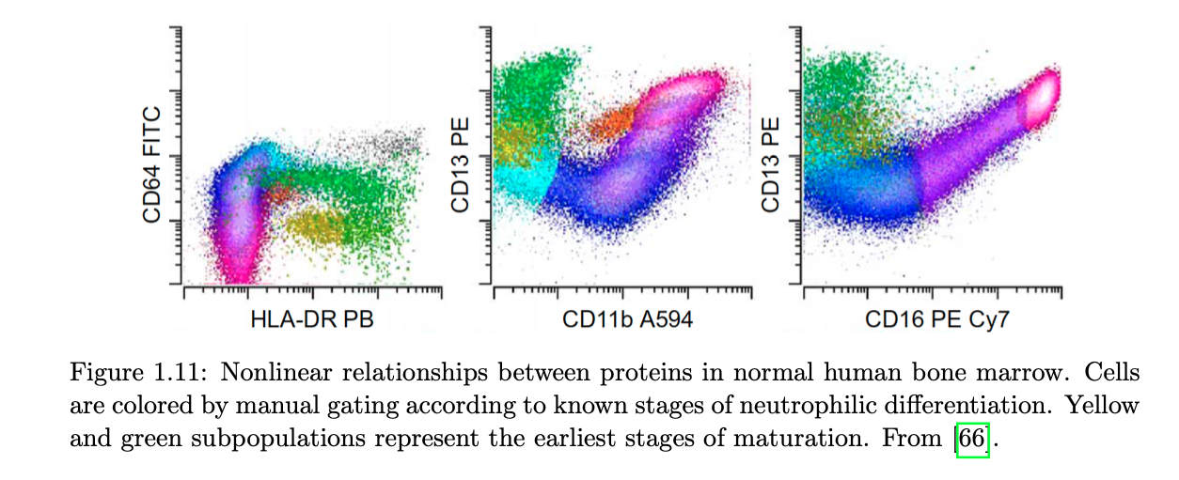
Non-linear relationships
Bendall, Sean C., et al. "Single-cell trajectory detection uncovers progression and regulatory coordination in human B cell development." Cell 157.3 (2014): 714-725.
Levine, Jacob Harrison. Learning cell states from high-dimensional single-cell data. Diss. Columbia University, 2016.

Slide 17
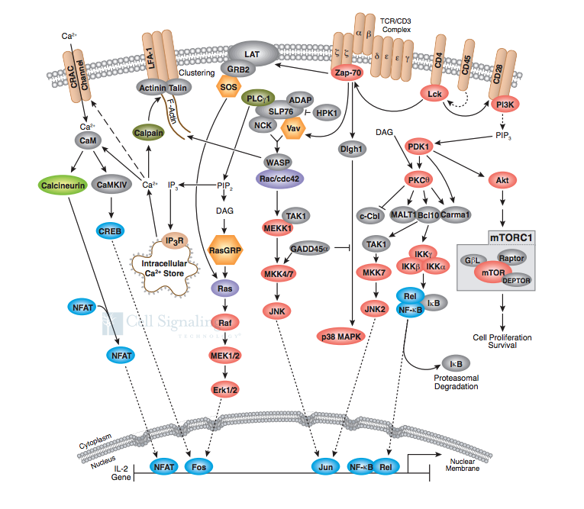
Why do we expect non-linearity in data?
Biological networks (gene network or protein networks) involve complex interactions such as feedback, feedforward, auto-regulation etc.
Results in non-linear relationships between genes and their products
Reflects as a well-regulated structure in phenotype space
https://media.cellsignal.com/www/pdfs/science/pathways/T_Cell_Receptor.pdf
Notes:
These properties come into play because biological networks (gene or protein) are complex.

Slide 18
Post data pre-processing: - Data normalization - Highly Variable Genes - PCA - Nearest Neighbor Graph - Visualization, Clustering

Slide 19
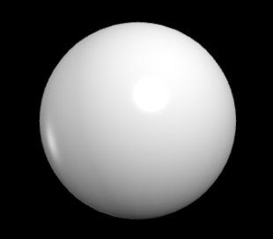
How do we handle non-linearity in data?
B
A
Notes:
These properties come into play because biological networks (gene or protein) are complex.

Slide 20
How do we handle non-linearity in data?
B
A
Notes:
These properties come into play because biological networks (gene or protein) are complex.

Slide 21
How do we handle non-linearity in data?
A
B
Notes:
These properties come into play because biological networks (gene or protein) are complex.

Slide 22
Non-linearity in the data
Gene C
Gene B
Gene A
Notes:
These properties come into play because biological networks (gene or protein) are complex.

Slide 23
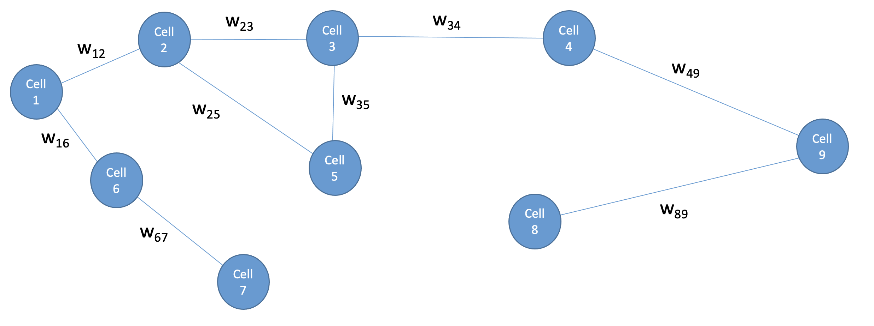
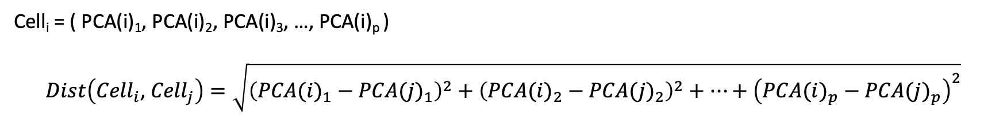
Graphs – applied to scRNA-seq data analysis
Gene C
Gene B
Gene A
We will construct graphs where:
Vertices = Cells
Edges = Connections between similar cells
Weights = Inversely dependent on distance between cells
How are distances computed?
Cell_{i} = ( PCA(i)₁, PCA(i)₂, PCA(i)₃, …, PCA(i)_{p} )
$$Dist\left({Cell}_{i}\text{,} { Cell}_{j}\right)=\sqrt{{\left({PCA(i)}_{1}−{PCA(j)}_{1}\right)}^{2}+{\left({PCA(i)}_{2}−{PCA(j)}_{2}\right)}^{2}+…+{\left({PCA(i)}_{p}−{PCA(j)}_{p}\right)}^{2}}$$

Slide 24
Graphs – applied to scRNA-seq data analysis
 | Cell 1 | Cell 2 | Cell 3 | Cell 4 | Cell 5 | Cell 6
Cell 1 | 0 | D(1, 2) | D(1, 3) | D(1, 4) | D(1, 5) | D(1, 6)
Cell 2 | D(2, 1) | 0 | D(2, 3) | D(2, 4) | D(2, 5) | D(2, 6)
Cell 3 | D(3, 1) | D(3, 1) | 0 | D(3, 4) | D(3, 5) | D(3, 6)
Cell 4 | D(4, 1) | D(4, 2) | D(4, 3) | 0 | D(4, 5) | D(4, 6)
Cell 5 | D(5, 1) | D(5, 2) | D(5, 3) | D(5, 4) | 0 | D(5, 6)
Cell 6 | D(6, 1) | D(6, 2) | D(6, 3) | D(6, 4) | D(6, 5) | 0
Algorithm:
Process data
PCA -> get top p components
Fix k
For each cell compute the distance to the k nearest cells
Distance metric is typically Euclidean
Results in a distance matrix like:
Keep only 3 nearest neighbors
 | Cell 1 | Cell 2 | Cell 3 | Cell 4 | Cell 5 | Cell 6
Cell 1 | 0 | D(1, 2) | D(1, 3) | 0 | 0 | D(1, 6)
Cell 2 | D(2, 1) | 0 | D(2, 3) | 0 | D(2, 5) | 0
Cell 3 | D(3, 1) | D(3, 1) | 0 | D(3, 4) | 0 | 0
Cell 4 | 0 | D(4, 2) | D(4, 3) | 0 | 0 | D(4, 6)
Cell 5 | 0 | D(5, 2) | 0 | D(5, 4) | 0 | D(5, 6)
Cell 6 | D(6, 1) | 0 | D(6, 3) | 0 | D(6, 5) | 0

Slide 25
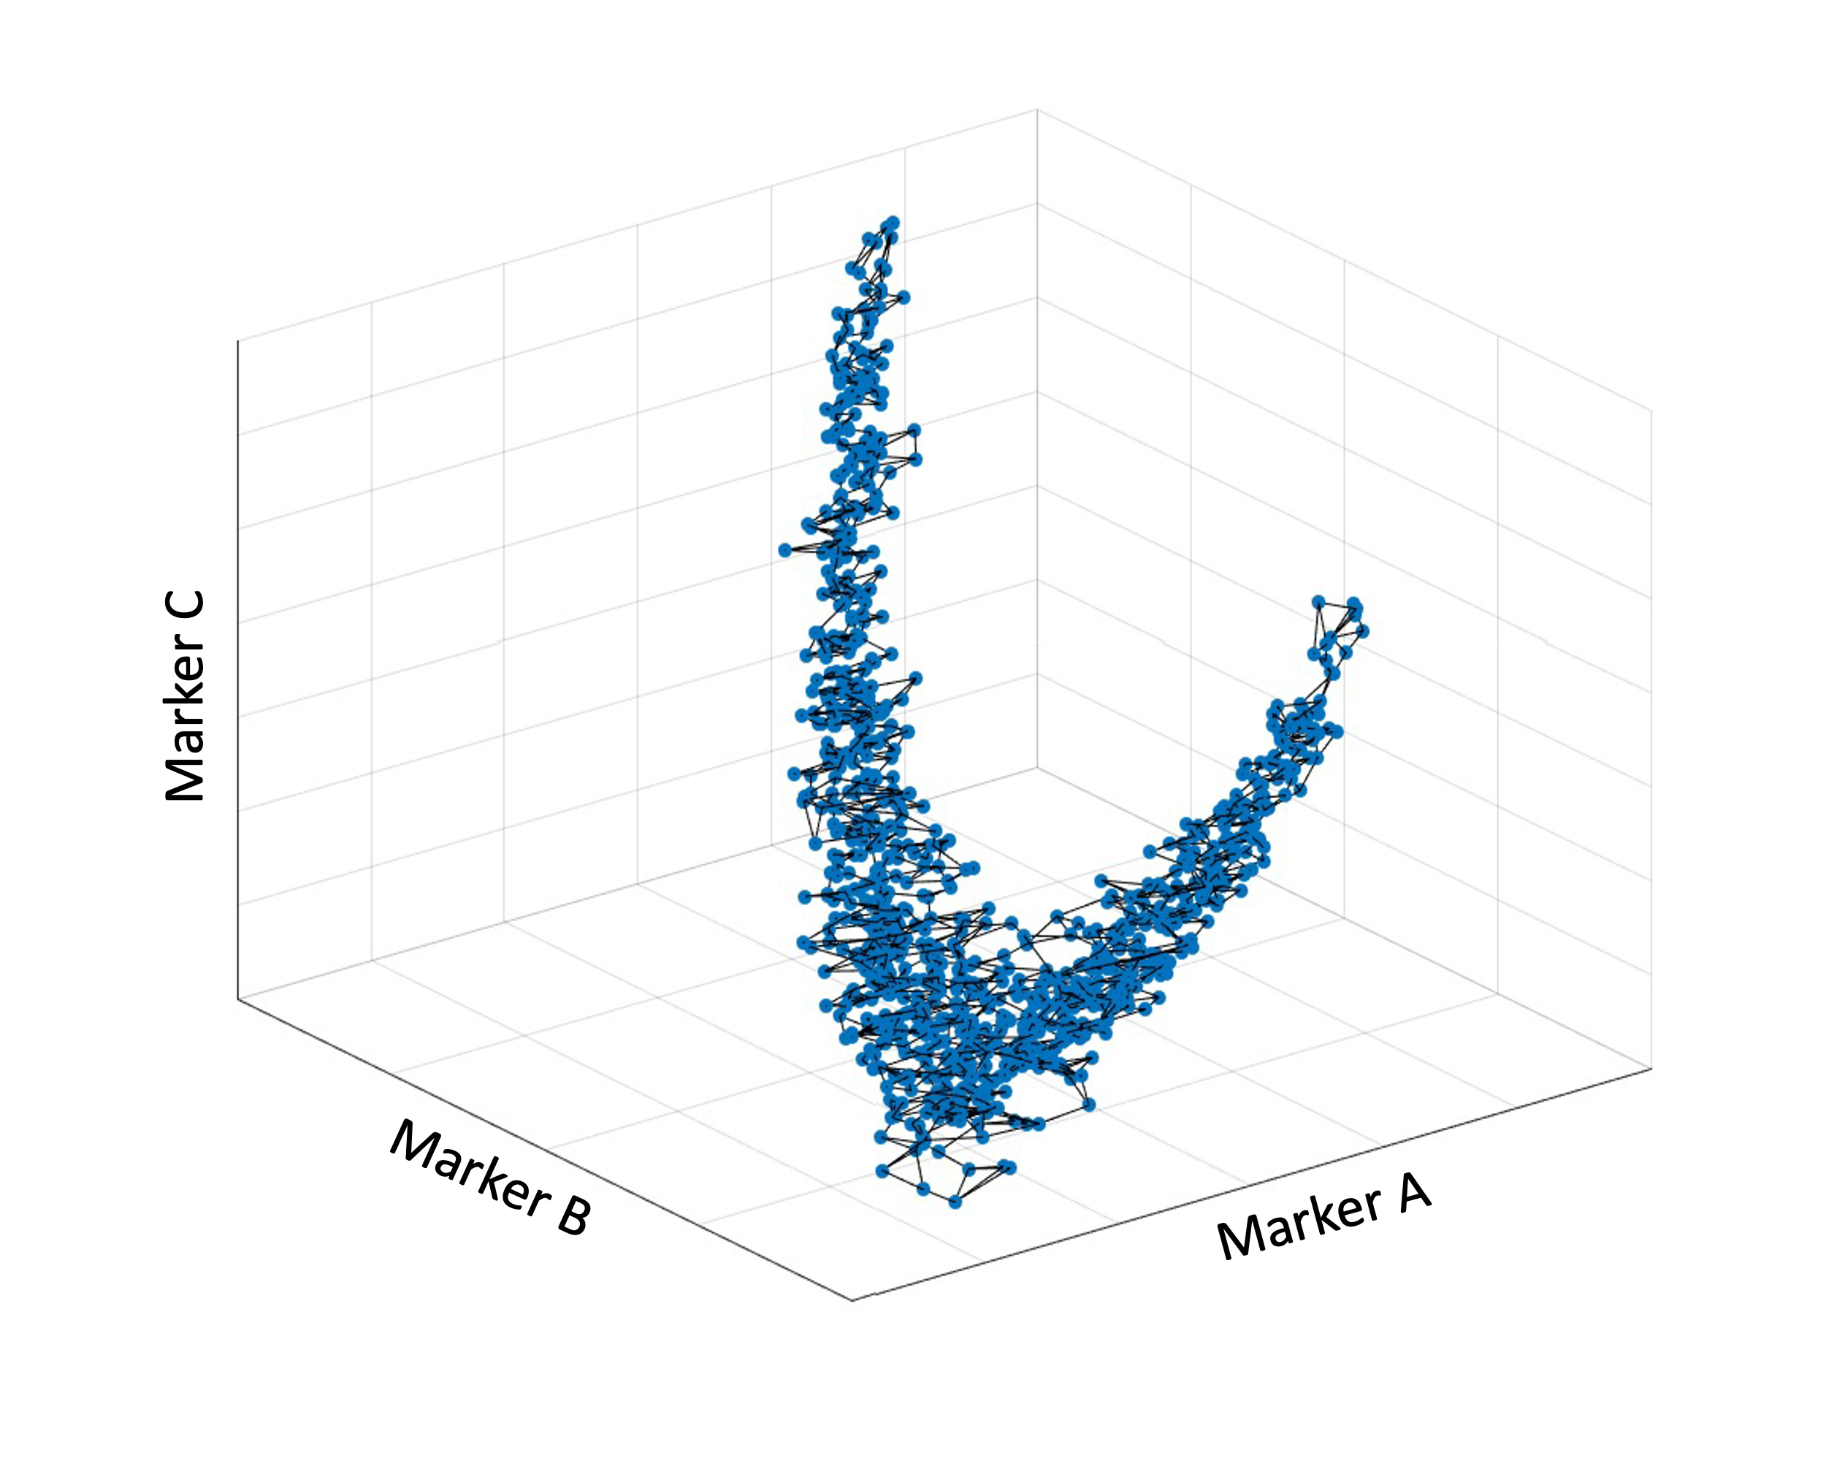
Graphs – applied to scRNA-seq data analysis
A
B

Slide 26
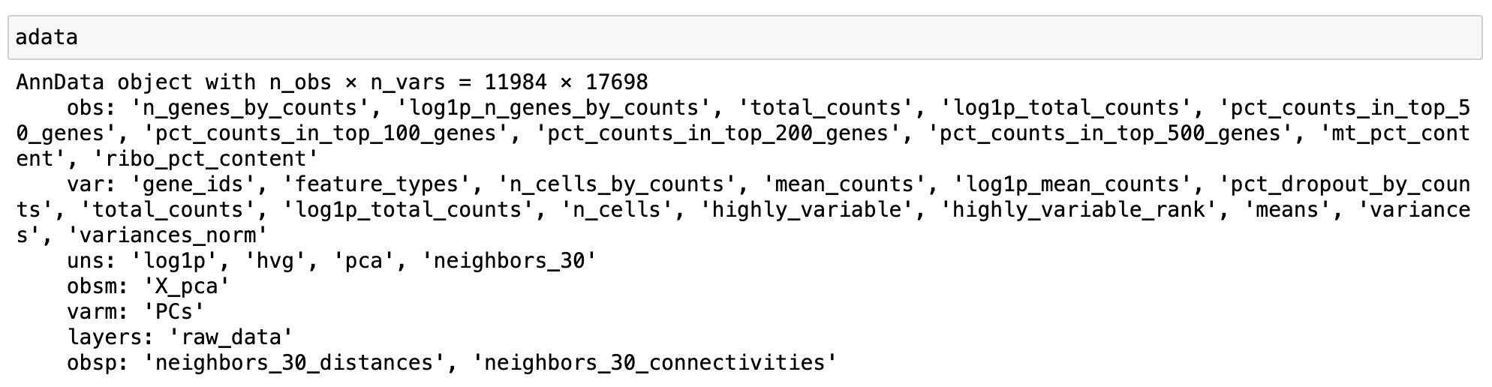
Computing knn-graph in Scanpy

Slide 27
Post data pre-processing: - Data normalization - Highly Variable Genes - PCA - Nearest Neighbor Graph - Visualization, Clustering

Slide 28
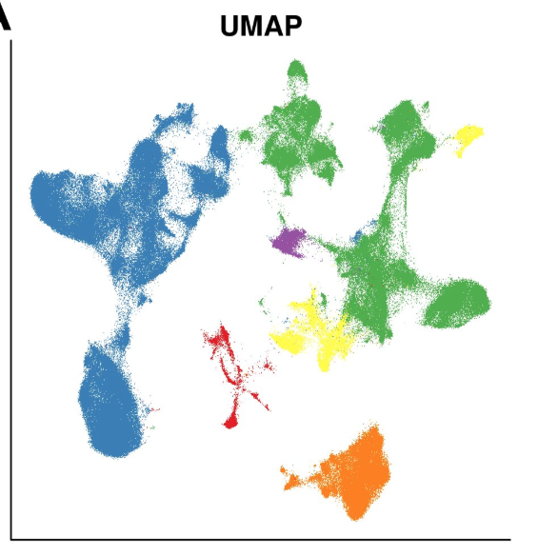
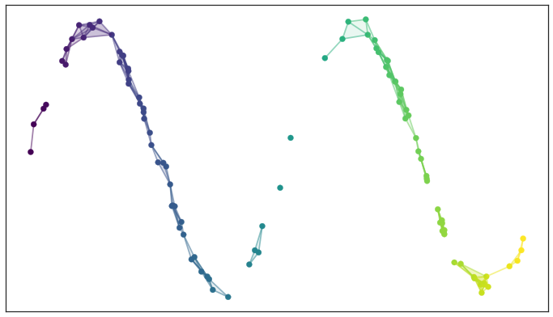
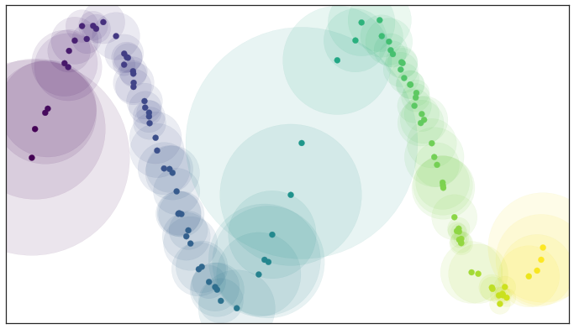
Data Visualization – UMAP
UMAP begins by constructing a graph structure of the data
The graph is converted into a weighted graph (“fuzzy topological structure”)
Find a representation in lower dimensions with similar topological structure (minimize cross-entropy of weights in the graph)
https://umap-learn.readthedocs.io/en/latest/how_umap_works.html
Becht et. al. Nature Biotech 2019

Slide 29
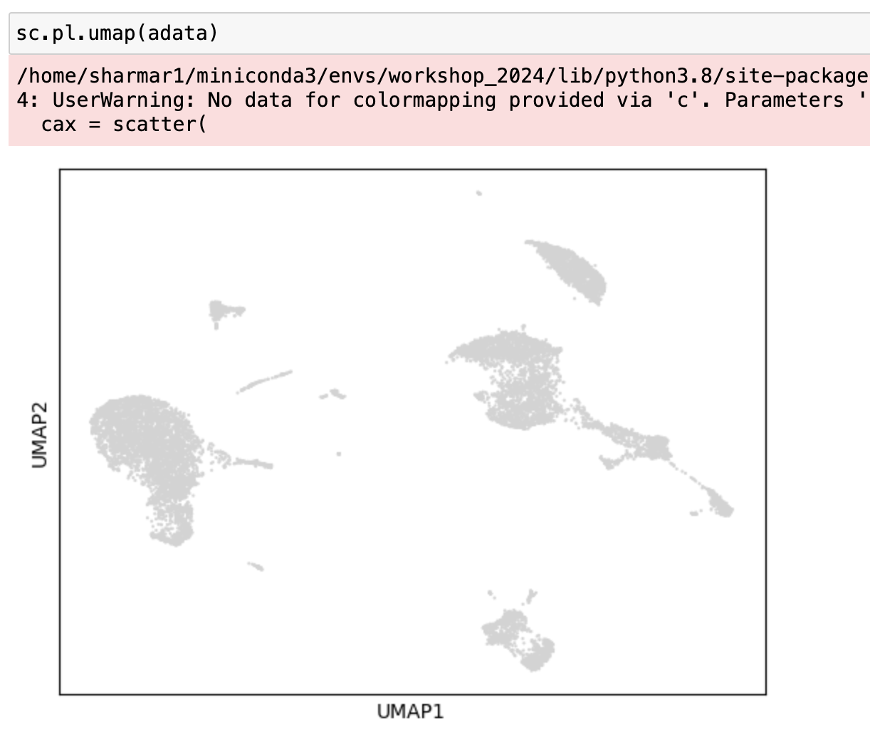
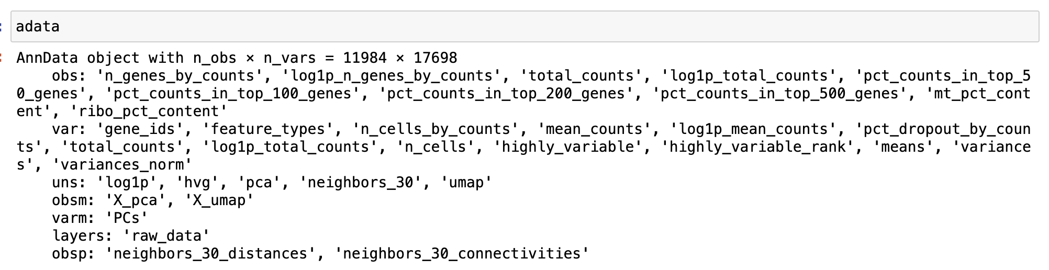
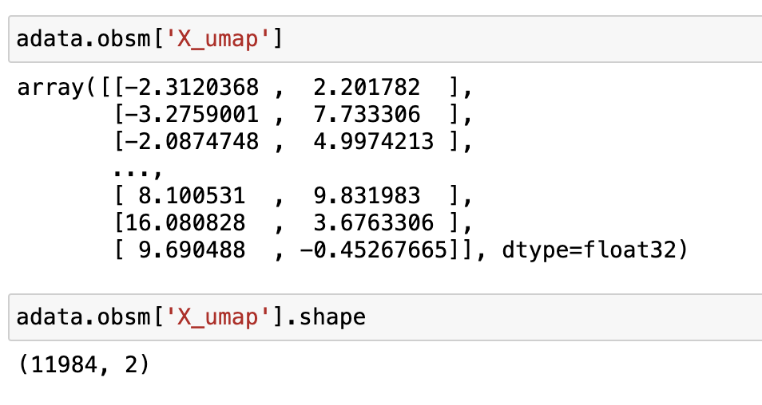
Data Visualization – UMAP

Slide 30
Visualizing data, metadata on UMAP

Slide 31
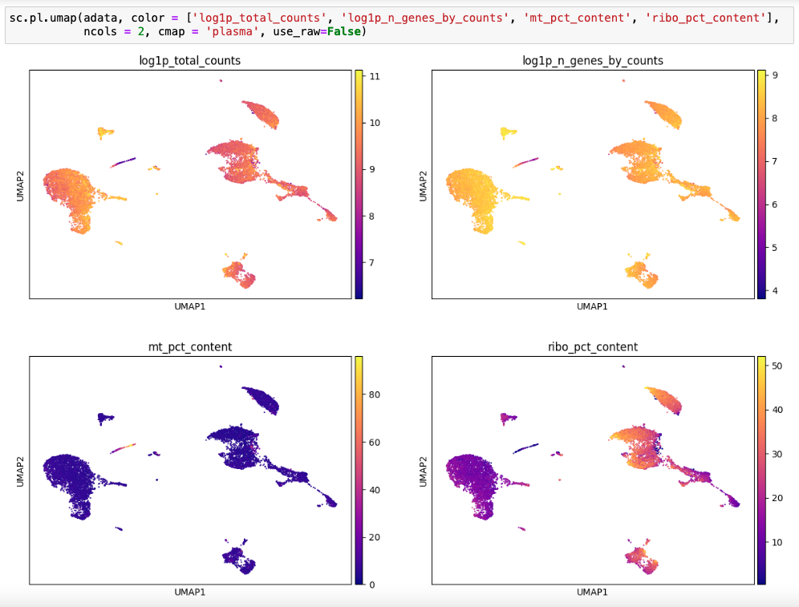
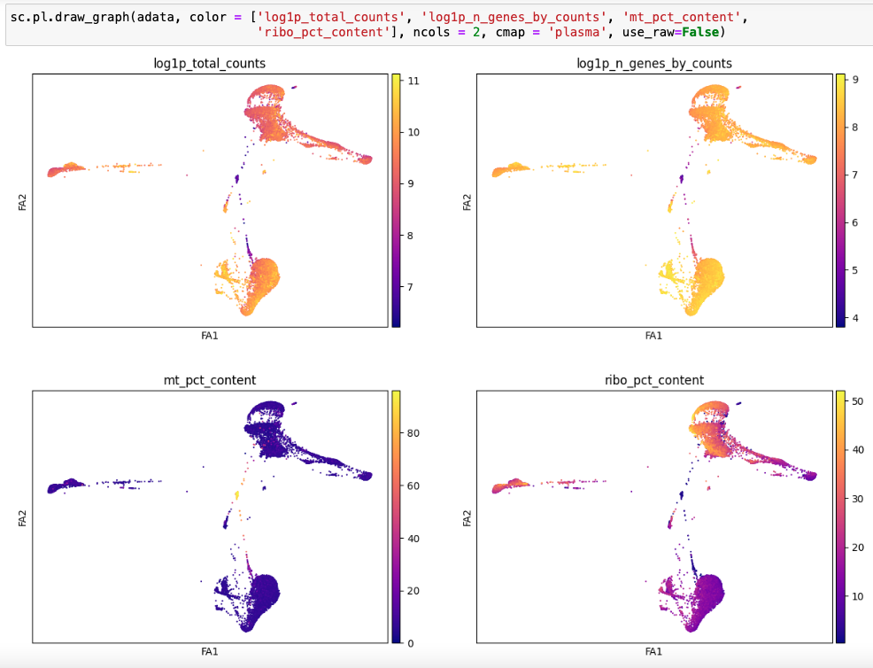
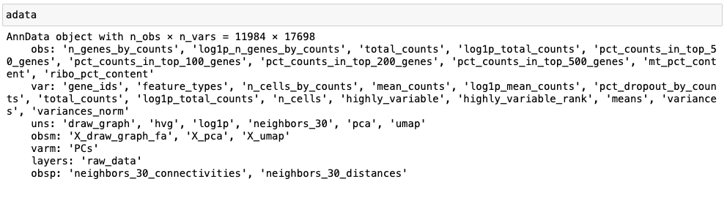
Utilizing visualizations for data analyses (Library size, number of unique genes per cell)

Slide 32
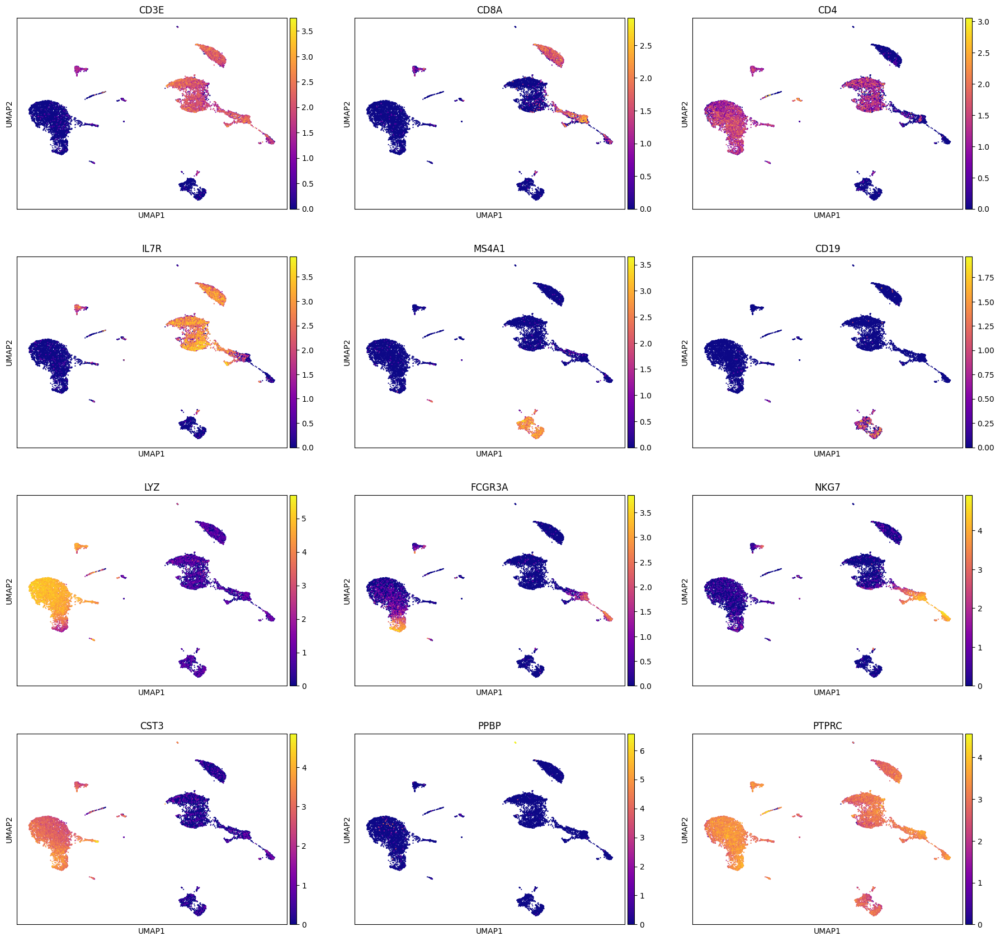
Gene expression on UMAP

Slide 33
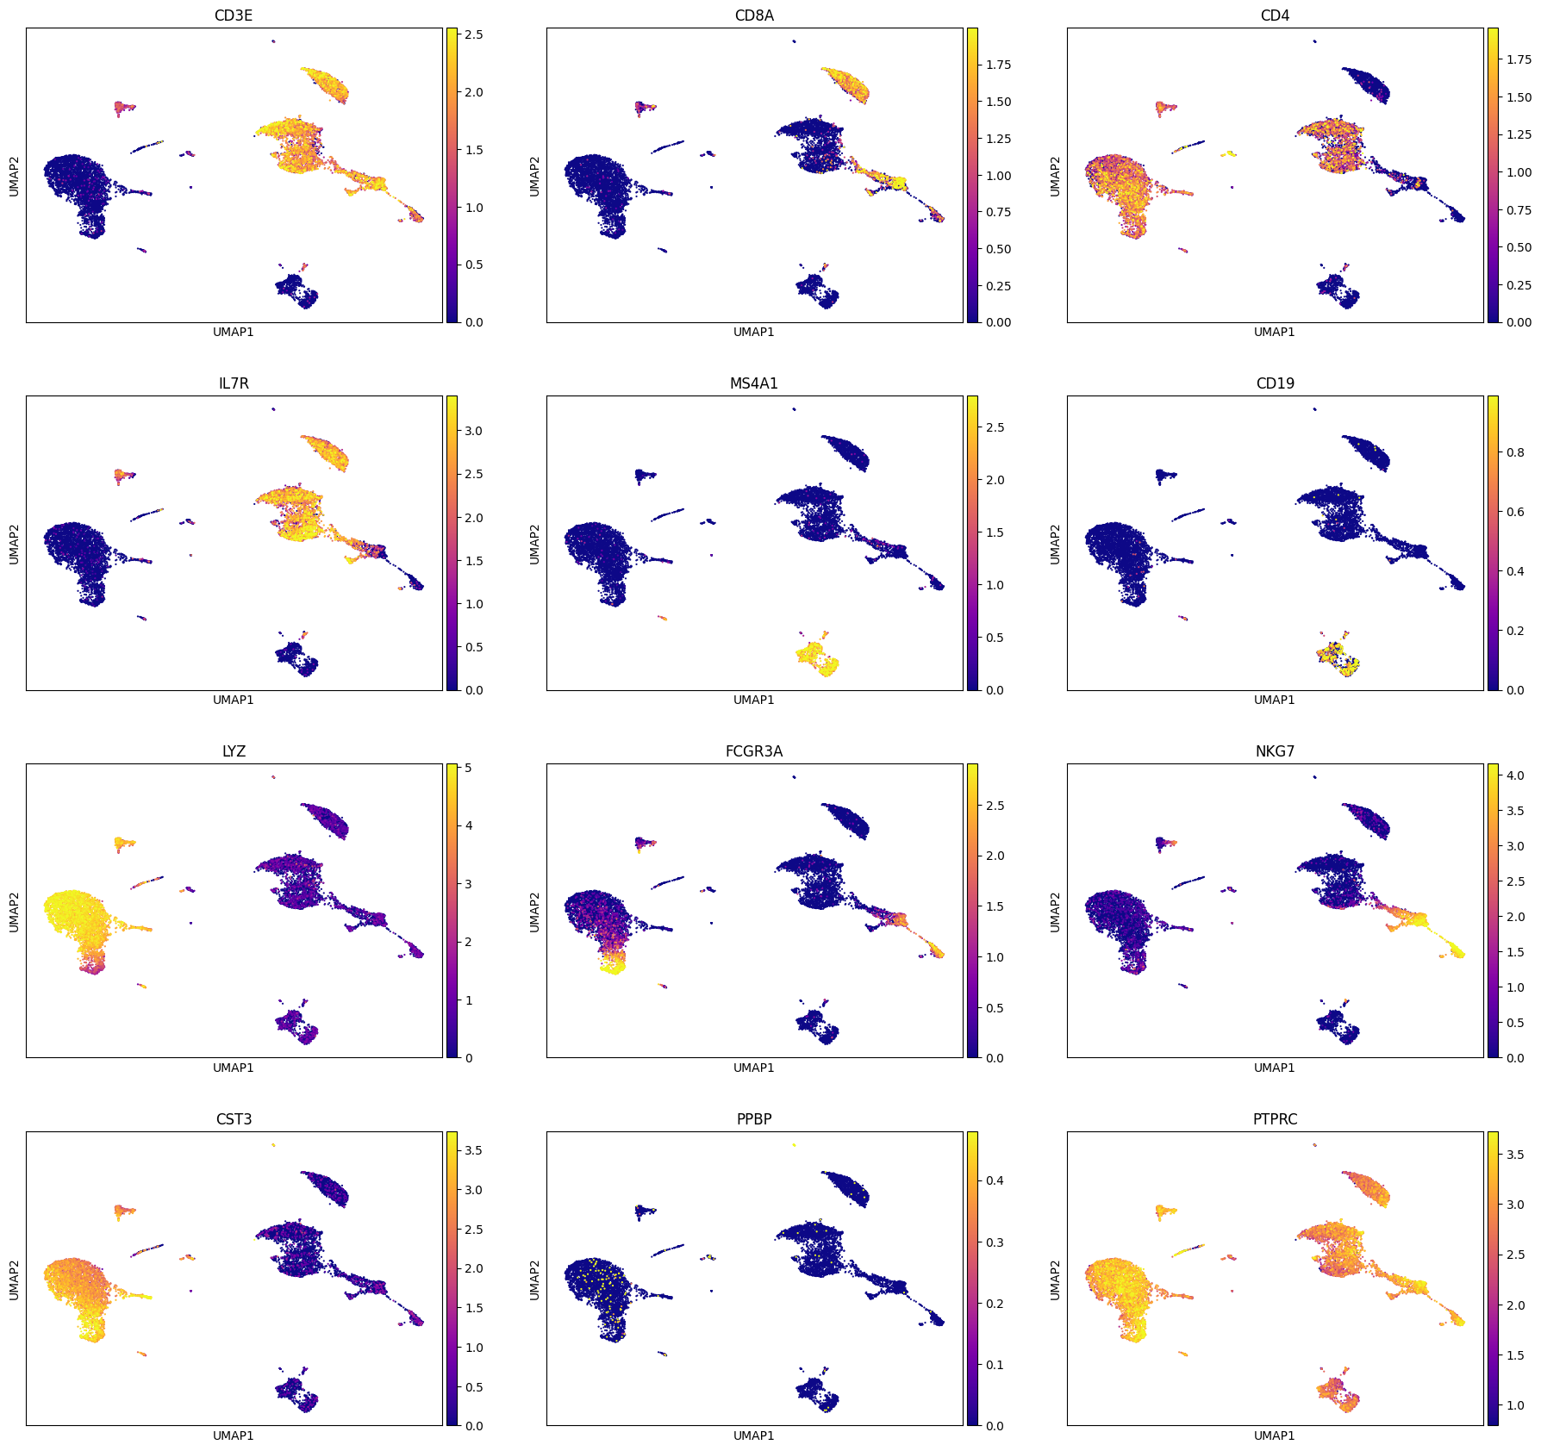
Gene expression on UMAP

Slide 34
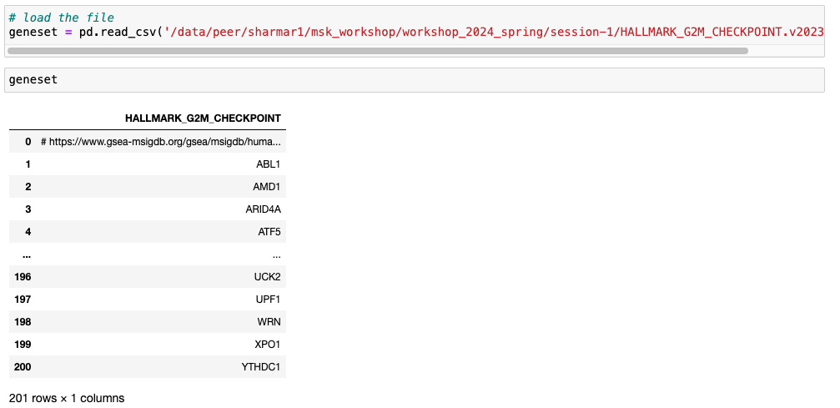
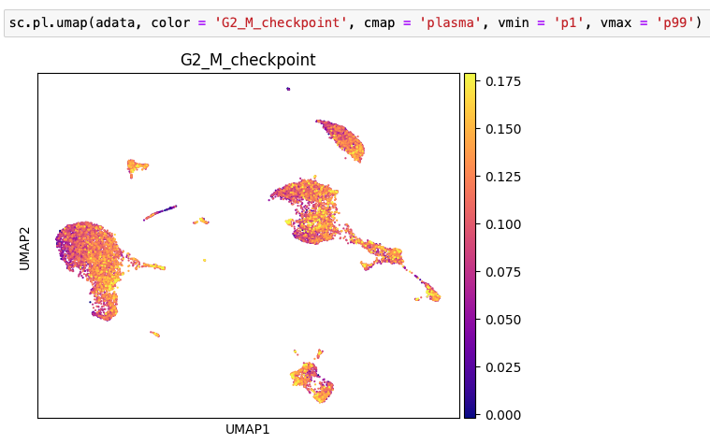
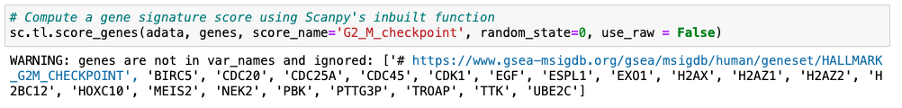
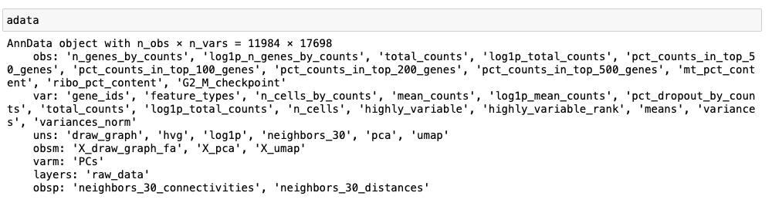
Gene signatures on UMAP

Slide 35
Generating hypotheses using UMAP

Slide 36
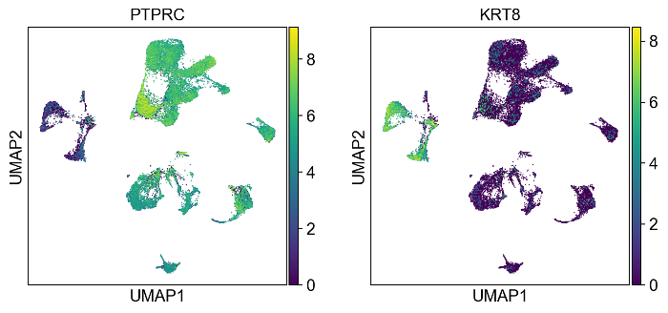
Utilizing visualizations for data analyses
https://www.nature.com/articles/s43018-022-00443-5#Sec54

Slide 37
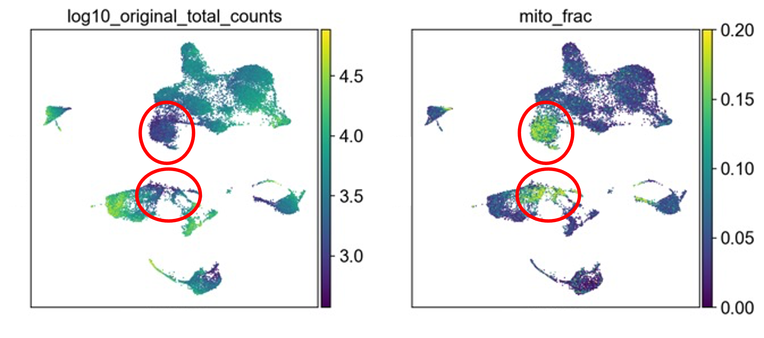
Utilizing visualizations for data analyses
https://www.nature.com/articles/s43018-022-00443-5#Sec54

Slide 38
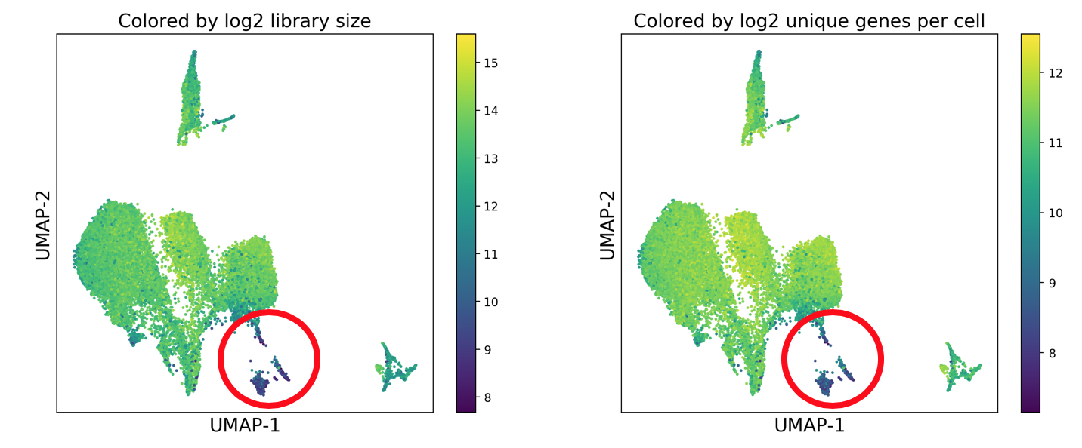
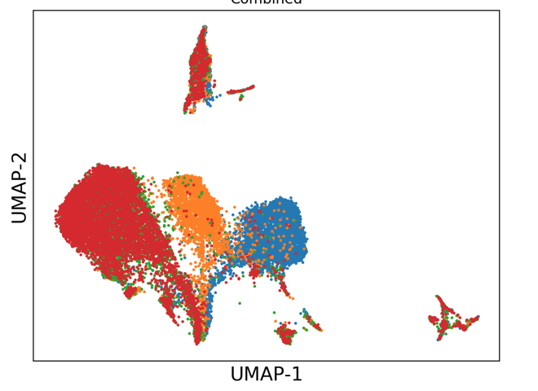
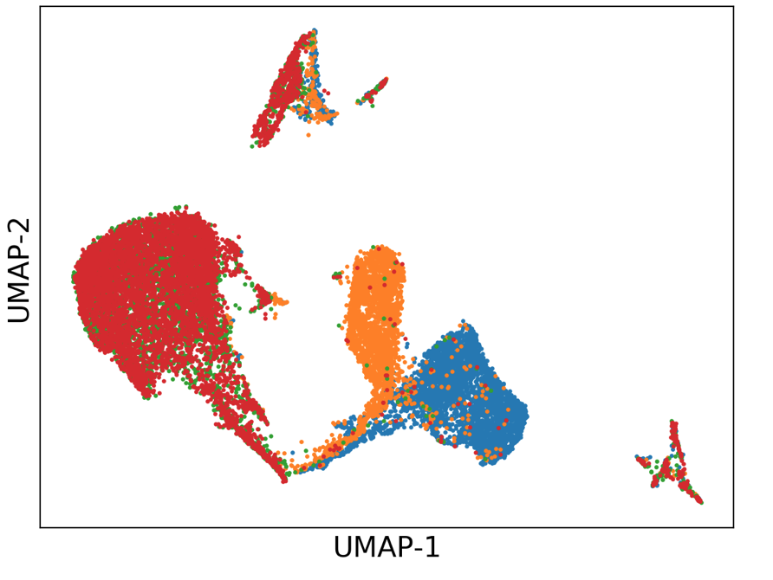
Utilizing visualizations for data analyses (Library size)
After removing the lowly expressed cells
[Data is from an unpublished work]

Slide 39
Application of graphs: Clustering

Slide 40
Cell clustering
Want: Identify cells that are similar to each other and group them together
We have already constructed similarity metric between cells based on the k-nearest neighbor graph
Then cells will be grouped based on some optimization metric
Consider two approaches:
Leiden clustering
Jaccard + Leiden clustering (PhenoGraph)
Marker C
Marker A
Marker B

Slide 41
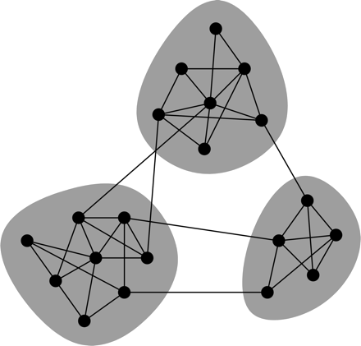
Leiden clustering
Shown to be optimal for different criteria such as Modularity and Constant Potts Model:
Modularity is a metric of connectedness
Try to maximize the number of edges within a cluster compared to an expected value
CPM measures the density of edges within a cluster against between clusters
Want more edges within a cluster
Want fewer edges between clusters

Slide 42
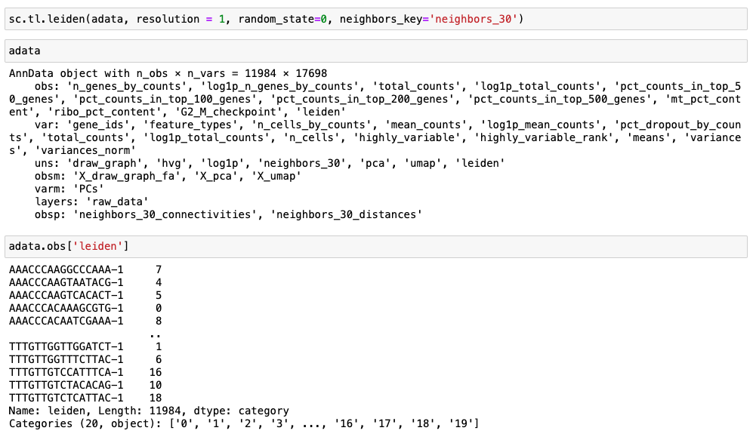
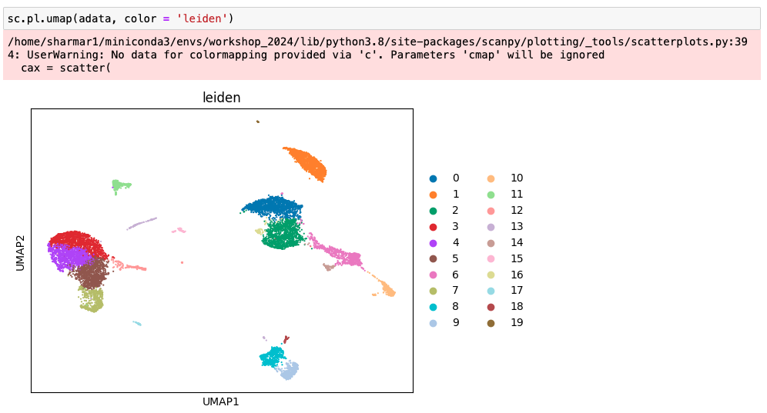
Leiden clustering in Scanpy

Slide 43
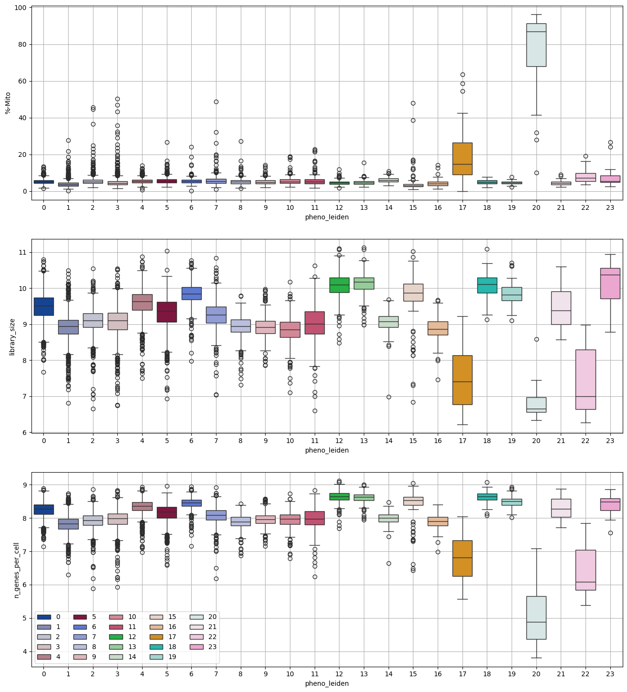

Applying clustering for data clean up
We have argued that we want to remove the circled set of cells.
We can now use the clusters we have to isolate and remove each cluster one at a time.

Slide 44
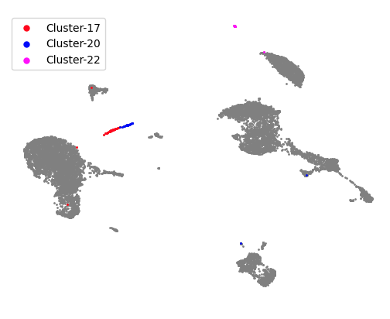
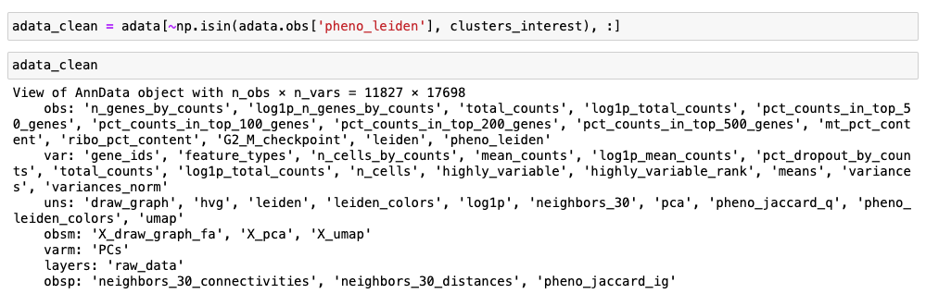
Applying clustering for data clean up

Slide 45
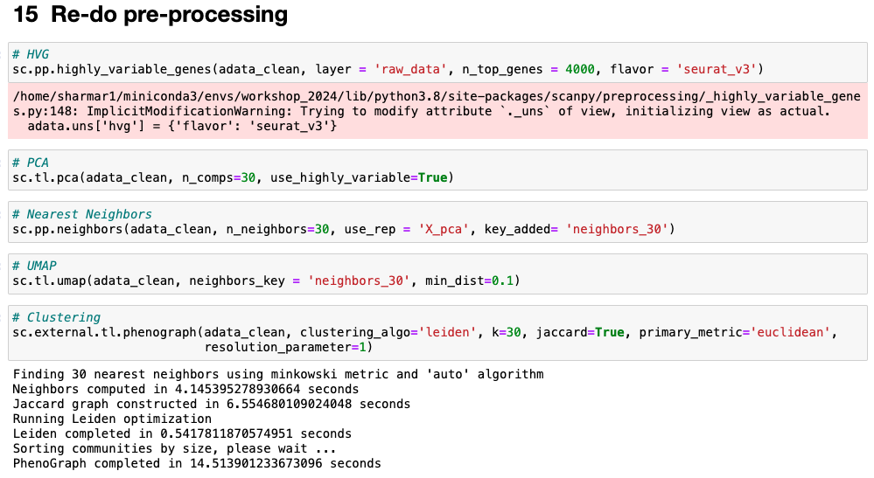
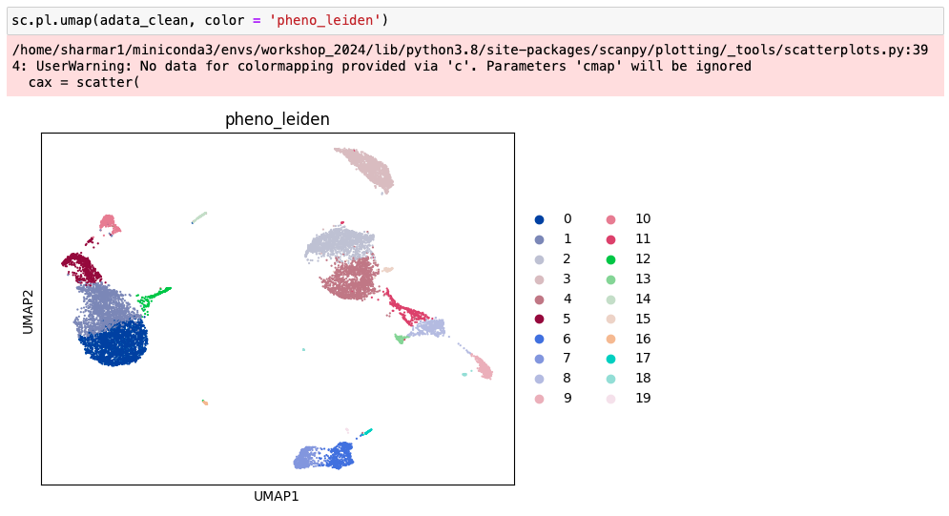
Re-do the pre-processing

Slide 46
Overview
Highly Variable Genes
Normalized data
Dimensionality Reduction (PCA)
Graphs
Using the visualization to guide data analysis
Visualization (tSNE, UMAP, Force Directed Layout)
Iterate until subset to the cells of interest
Applications of graphs:
Doublet detection; Clustering; DEGs

Slide 47
DE genes
UMAP-2
UMAP-1
Compare the gene expression distribution in green cells vs. red cells for every gene
Extract genes that are significantly different based on statistical tests

Slide 48
scRNA-seq is a more complex data type
Bulk Data
scRNA-seq Data
Gene | Abundance
B3GAT2 | 48
NPL | 122
T2 | 87
1700010I14RIK | 34
AK020722 | 88
B930003M22RIK | 25
AK163153 | 258
AGPAT4 | 329
MAP3K4 | 89
IGF2R | 608
AIRN | 48
MRPL18 | 1352
TCP1 | 1236
RNASEL | 629
ACAT2 | 513
Gene | Cell 1 | Cell 2 | Cell 3 | … | Cell N
B3GAT2 | 0 | 1 | 0 | … | 0
NPL | 0 | 0 | 1 | … | 0
T2 | 0 | 0 | 0 | … | 0
1700010I14RIK | 0 | 1 | 0 | … | 0
AK020722 | 0 | 0 | 0 | … | 1
B930003M22RIK | 0 | 0 | 1 | … | 0
AK163153 | 0 | 1 | 0 | … | 0
AGPAT4 | 0 | 0 | 0 | … | 0
MAP3K4 | 1 | 0 | 0 | … | 0
IGF2R | 2 | 0 | 0 | … | 0
AIRN | 0 | 2 | 0 | … | 0
MRPL18 | 0 | 0 | 0 | … | 0
TCP1 | 3 | 0 | 0 | … | 0
RNASEL | 0 | 1 | 2 | … | 0
ACAT2 | 1 | 1 | 0 | … | 0

Slide 49
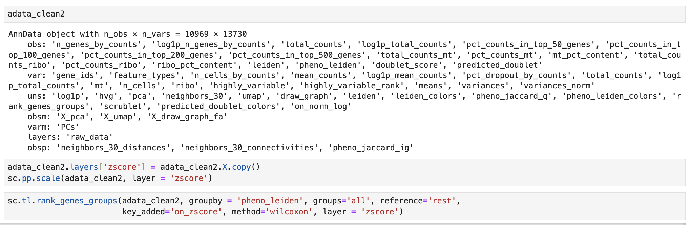
Example Scanpy inbuilt- quick check
The rank_genes_groups computation can also be done in z-scored data. This is the default FindMarkers function in Seurat.

Slide 50
Analysis post Differential Expression
$$Score=−1 ∗log10\left(pvalue\right)∗sign(coef)$$
Genes | P-value | Coefficient/log-fold-change
Gene1 | … | …
Gene2 | … | …
Gene3 | … | …
Gene4 | … | …
Gene5 | … | …
Gene6 | … | …
Gene7 | … | …
Gene8 | … | …
Gene9 | … | …
Gene10 | … | …
Gene11 | … | …
Gene Ranking | Score
Gene1 | …
Gene2 | …
Gene3 | …
Gene4 | …
Gene5 | …
Gene6 | …
Gene7 | …
Gene8 | …
Gene9 | …
Gene10 | …
Gene11 | …
UMAP-2
UMAP-1
Gene Pathway (+ve in Red) | Score
Gene Pathway 1 | …
Gene Pathway 2 | …
Gene Pathway 3 | …
Gene Pathway 4 | …
Gene Pathway 5 | …
Gene Pathway (+ve in Green) | Score
Gene Pathway 1 | …
Gene Pathway 2 | …
Gene Pathway 3 | …
Gene Pathway 4 | …
Gene Pathway 5 | …
Given a collection of biological pathways (or gene sets) GSEA compares which pathways do the top ranking genes belong to. Accordingly, it ranks the pathways that are positively expressed and the pathways that are negatively expressed in red cluster vs green cluster.
GSEA algorithm

Slide 51
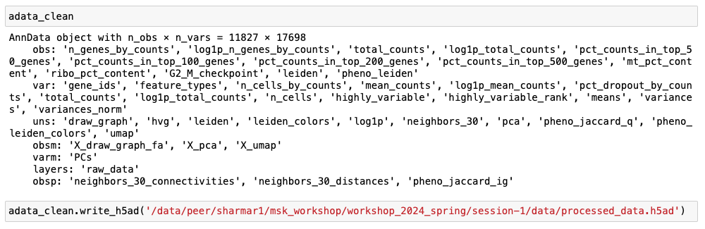
Saving results
The adata you want to save
Full path with filename, note the h5ad extension

